Slide 1
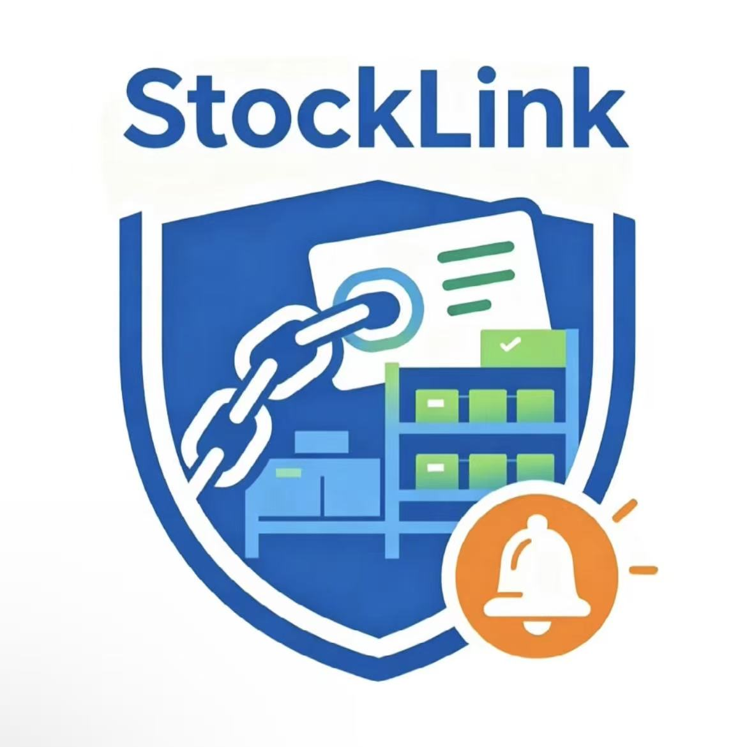

StockLink: Connecting Orders, Inventory and Smarter Decisions
Product Name：StockLink
Position：Order-Driven Inventory Risk Automation
Team Name: RM15 Refunders
Team Members: Wang Yanfeng,Liu Jiaming,
Zhou Xiaduo,Geng Ruixi,Gao Zijun
Core purpose: StockLink is an automated tool that connects orders with inventory.
Introduce：StockLink connects customer orders, ingredient inventory and incoming deliveries to identify stockout risks early and recommend actions for human approval.

Slide 2
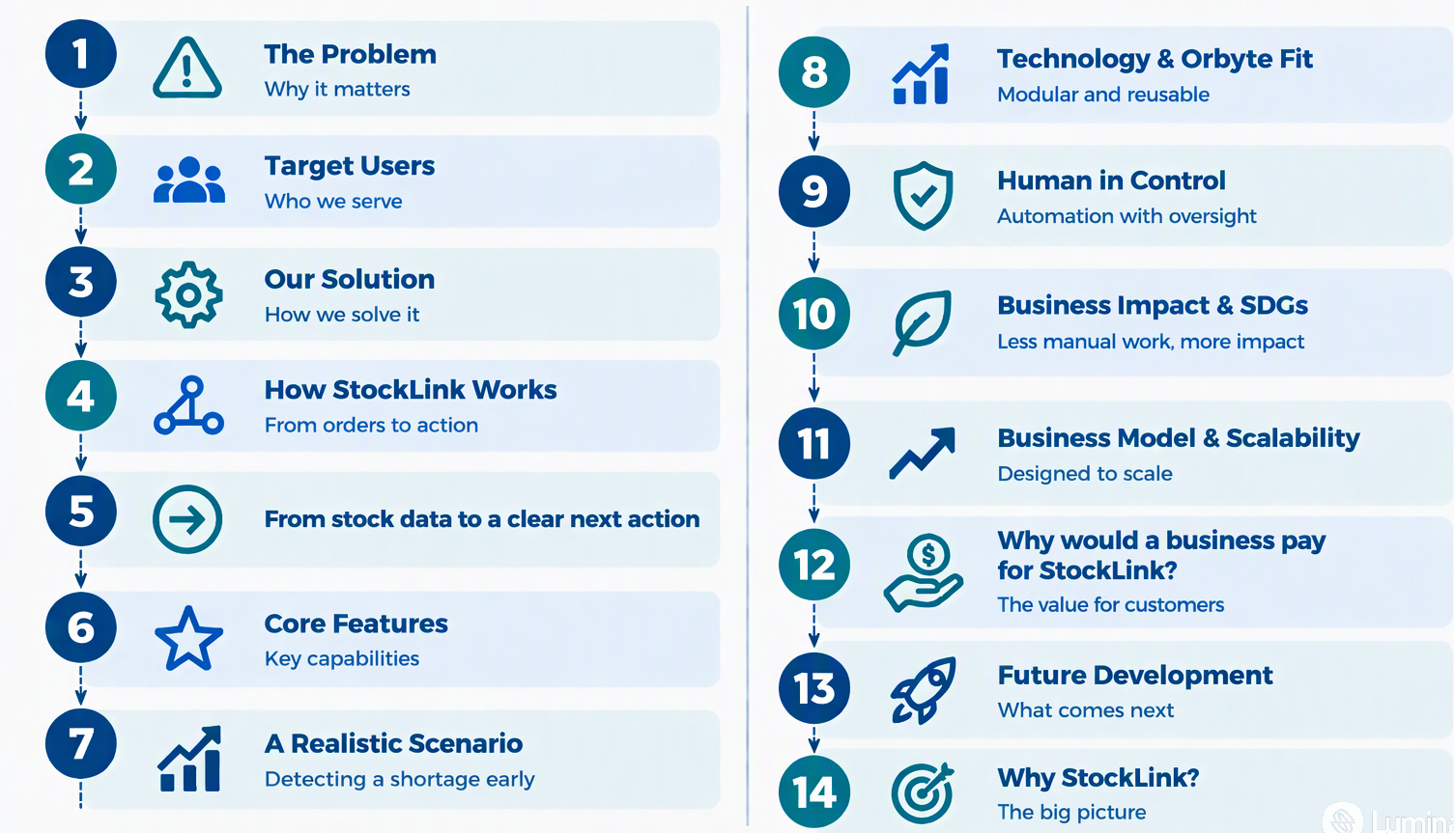
CONTENT

Slide 3

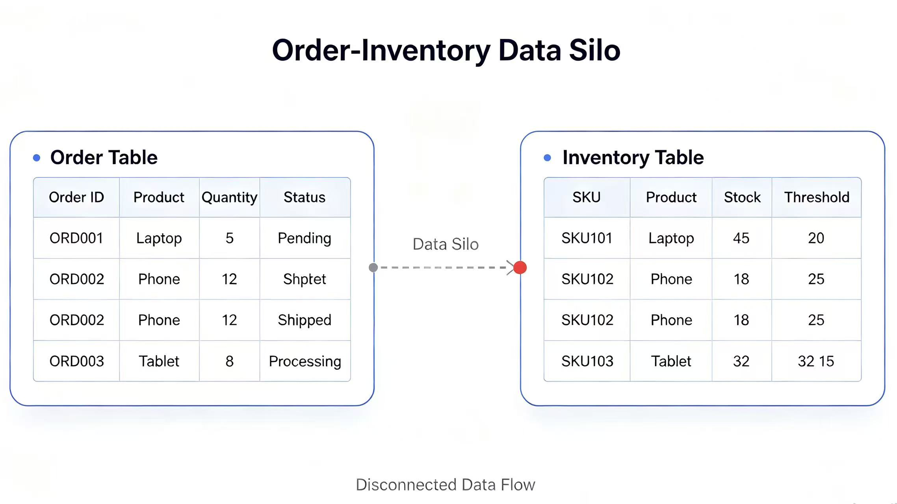
Small Businesses Struggle to Keep Orders and Inventory in Sync ?
The Problem
Customer orders and inventory records are fragmented. Store owners rely on manual calculations to determine raw material requirements.

Slide 4


Target Users
Built for Micro and small Business
Example Scenario:
A café receives a new order and needs to check whether it has enough milk, coffee beans and other ingredients, and whether existing purchase orders can replenish its stock on time.

Slide 5
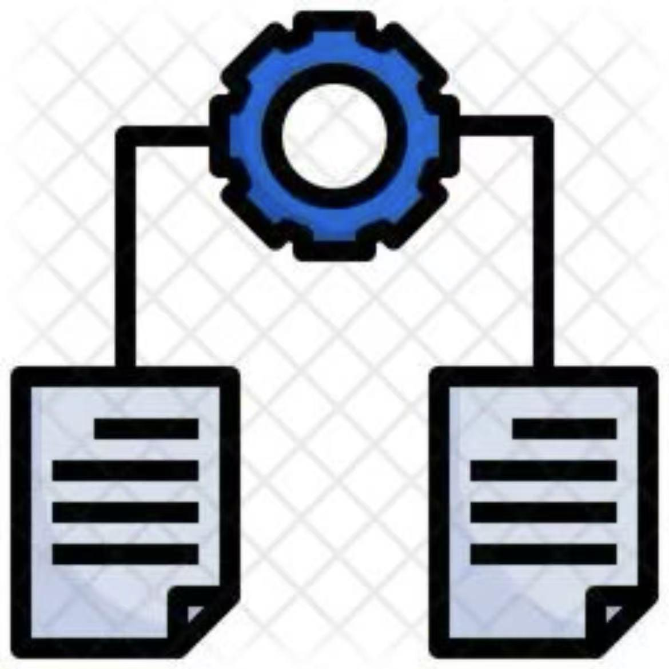
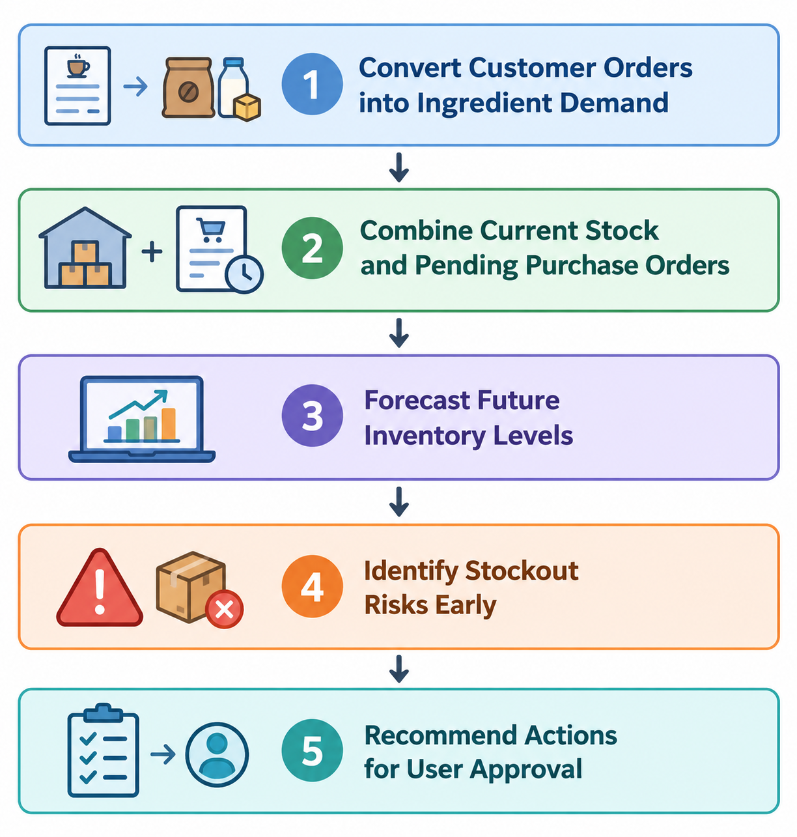
Our solution
One connected view of orders,stock and incoming supplies
Key Capabilities:
1.Convert Customer Orders into Ingredient Demand
2.Combine Current Stock and Pending Purchase Orders
3.Forecast Future Inventory Levels
4.Identify Stockout Risks Early
5.Recommend Actions for User Approval

Slide 6

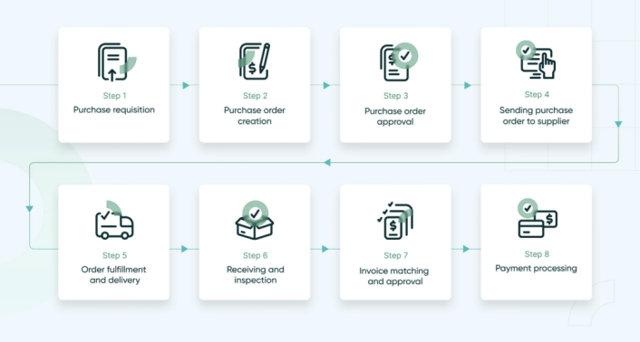
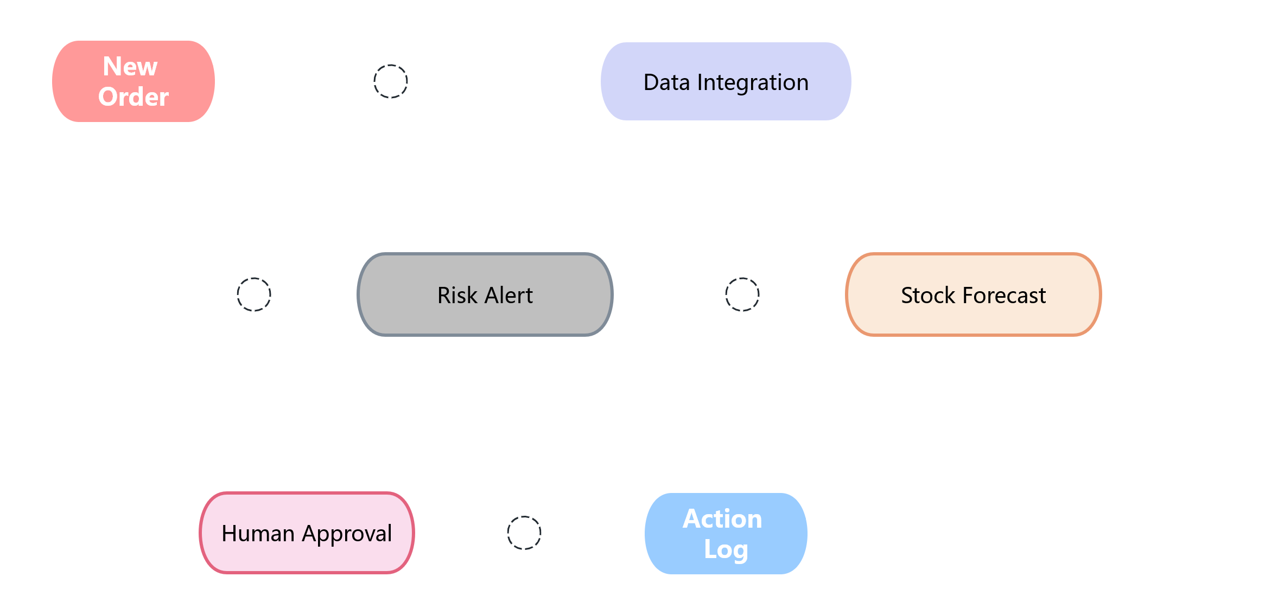
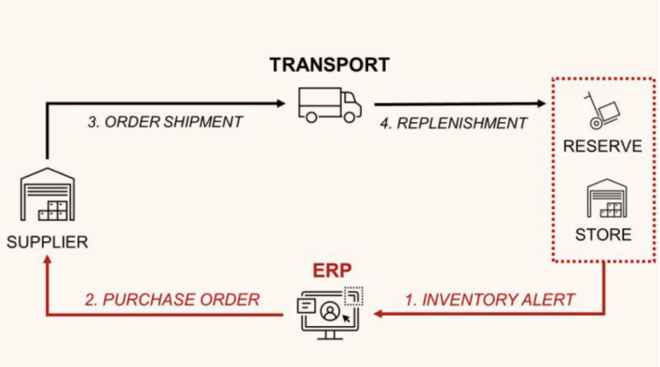
How StockLink Works
From New Orders to Actionable Alerts

Slide 7
From stock data to a clear next action
A practical workflow for a small café, bakery or restaurant.
01
02
03
04
05
Order arrives
Forecast updates
Risk explained
Person approves
Action recorded
›
›
›
›
Confirmed orders create ingredient demand.
Stock is projected against demand and delivery timing.
StockLink shows why a shortage may happen.
A user reviews a suggested supplier follow-up.
The decision and result appear in the activity log.
EXPECTED OPERATIONAL BENEFITS
Fewer surprises
Less manual chasing
Clear accountability
Spot risk early enough for teams to respond.
Reduce repeated checks across messages and spreadsheets.
Keep decisions, approvals and outcomes traceable.

Slide 8
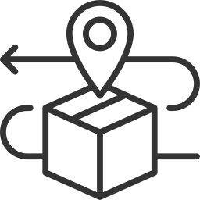
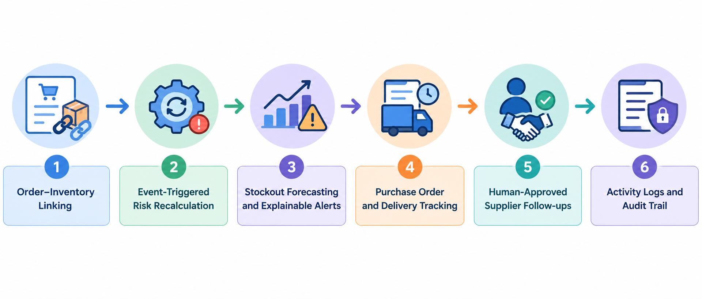
Core Features
StockLink connects orders, inventory, and supplier deliveries to predict stock shortages, generate actionable alerts, and recommend replenishment actions for human approval.

Slide 9

A Realistic Scenario
Detecting a Shortage Before It Happens
Example: Fresh milk inventory tracking at a local community shop.
Current Milk Stock
Daily Expected Demand
Supplier Delivery
Safety Stock
30 L
12 L / day
In 3 Days
5 L
System Alert: Current stock cannot cover demand until the next delivery, with only 30L for 3 days of 12L/day demand. StockLink triggers a reorder suggestion before the shop runs out of milk.

Slide 10
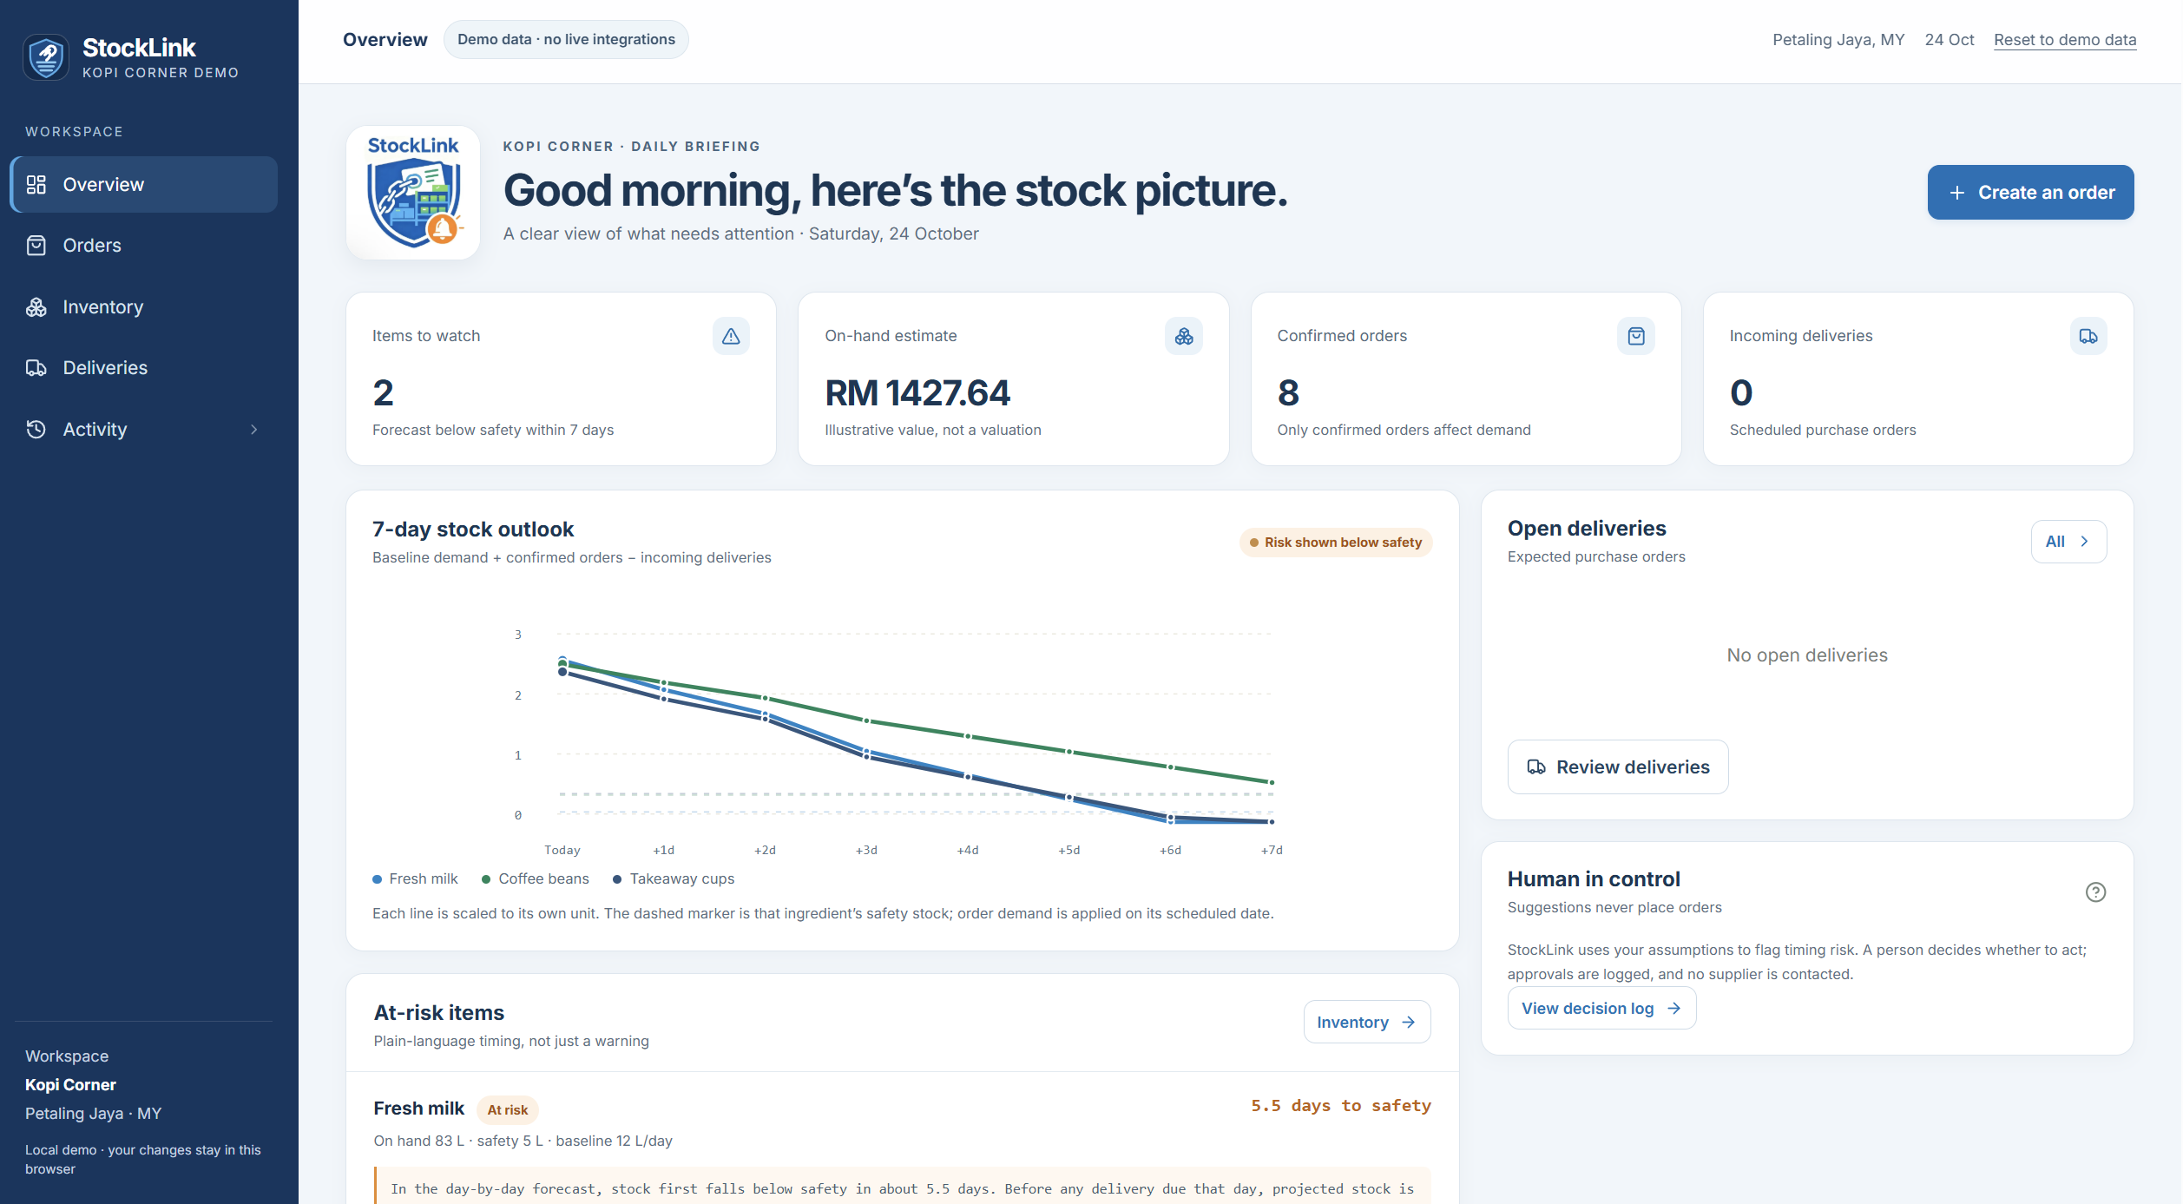
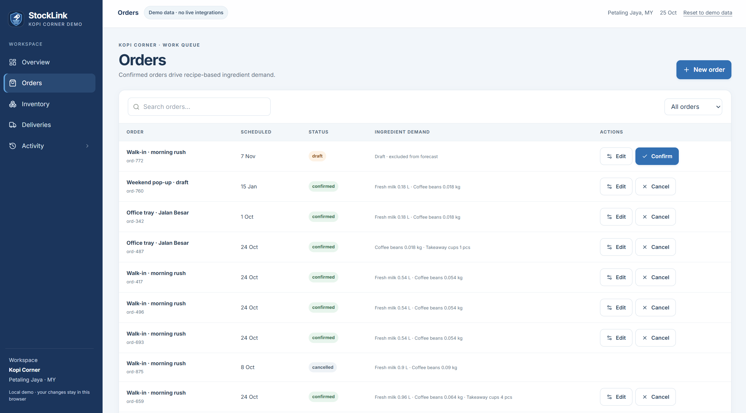
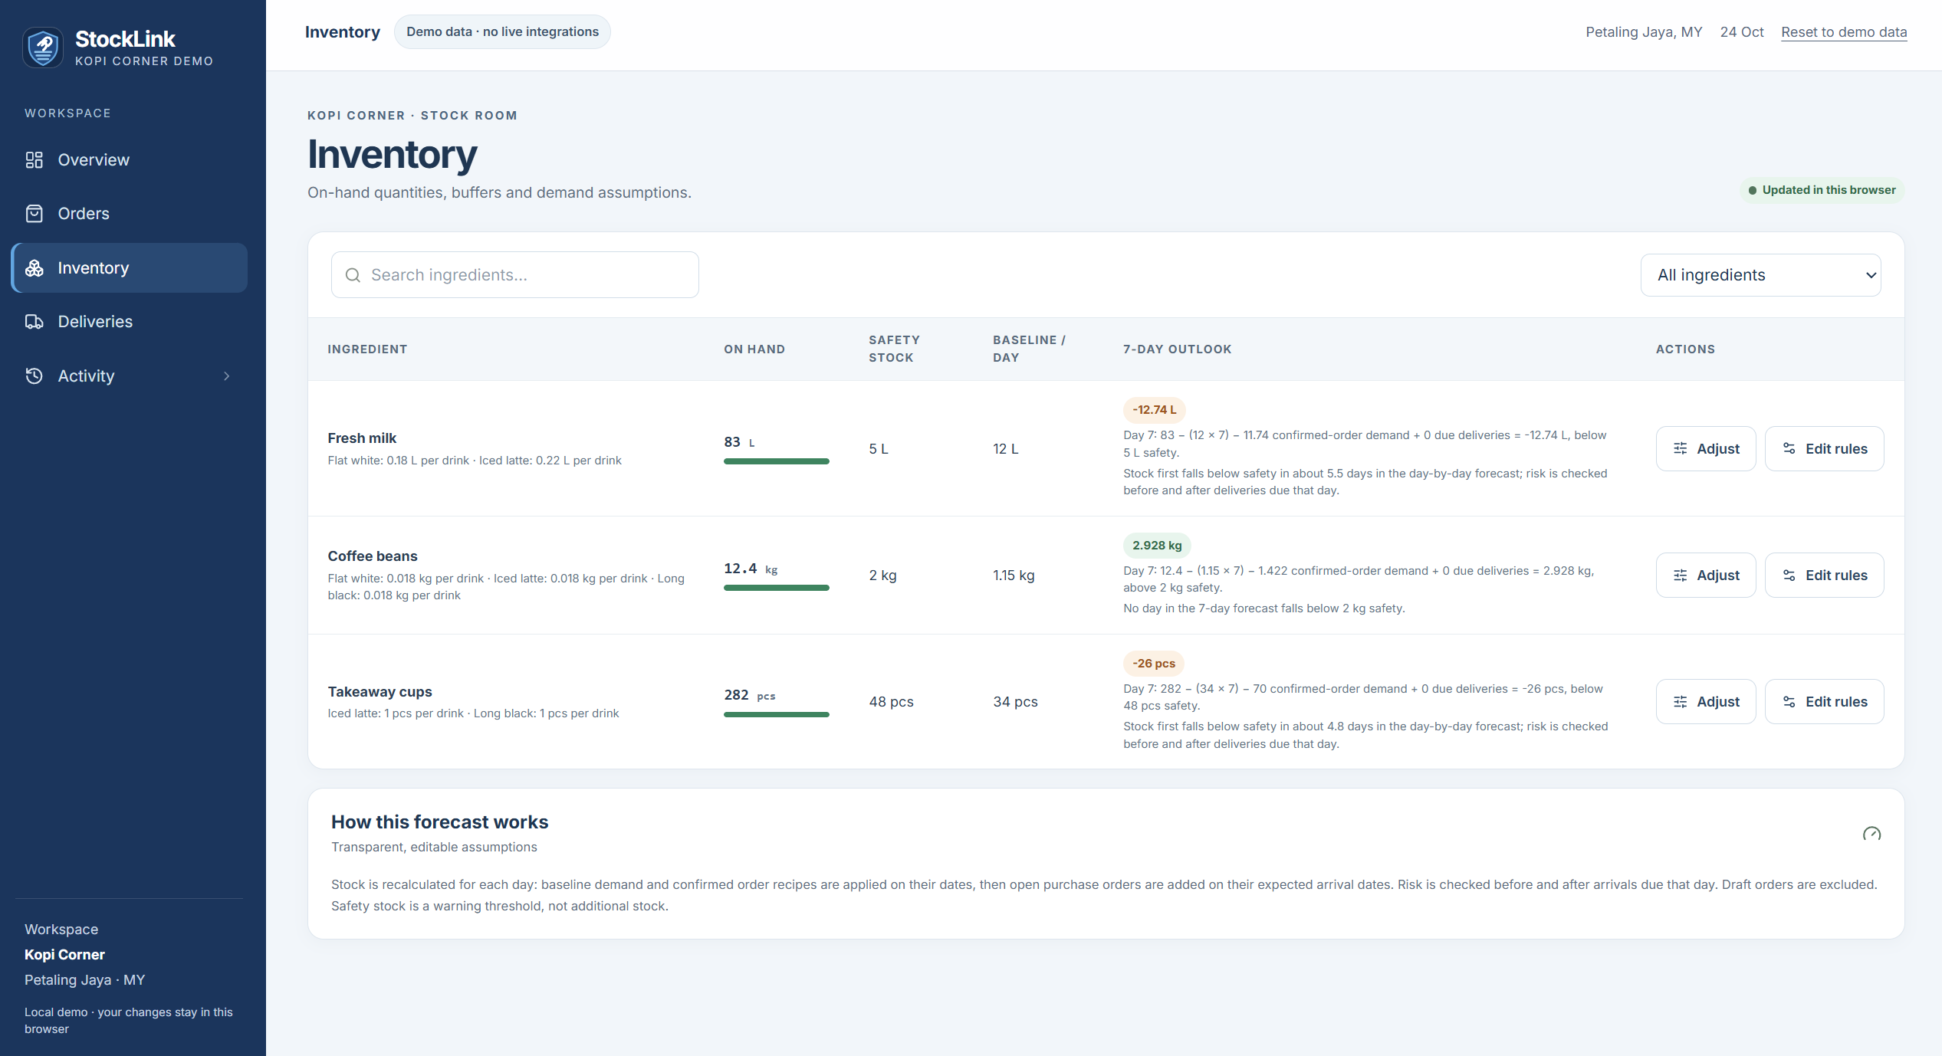
Technology & Orbyte Fit
A Modular and Reusable Automation Component

Slide 11
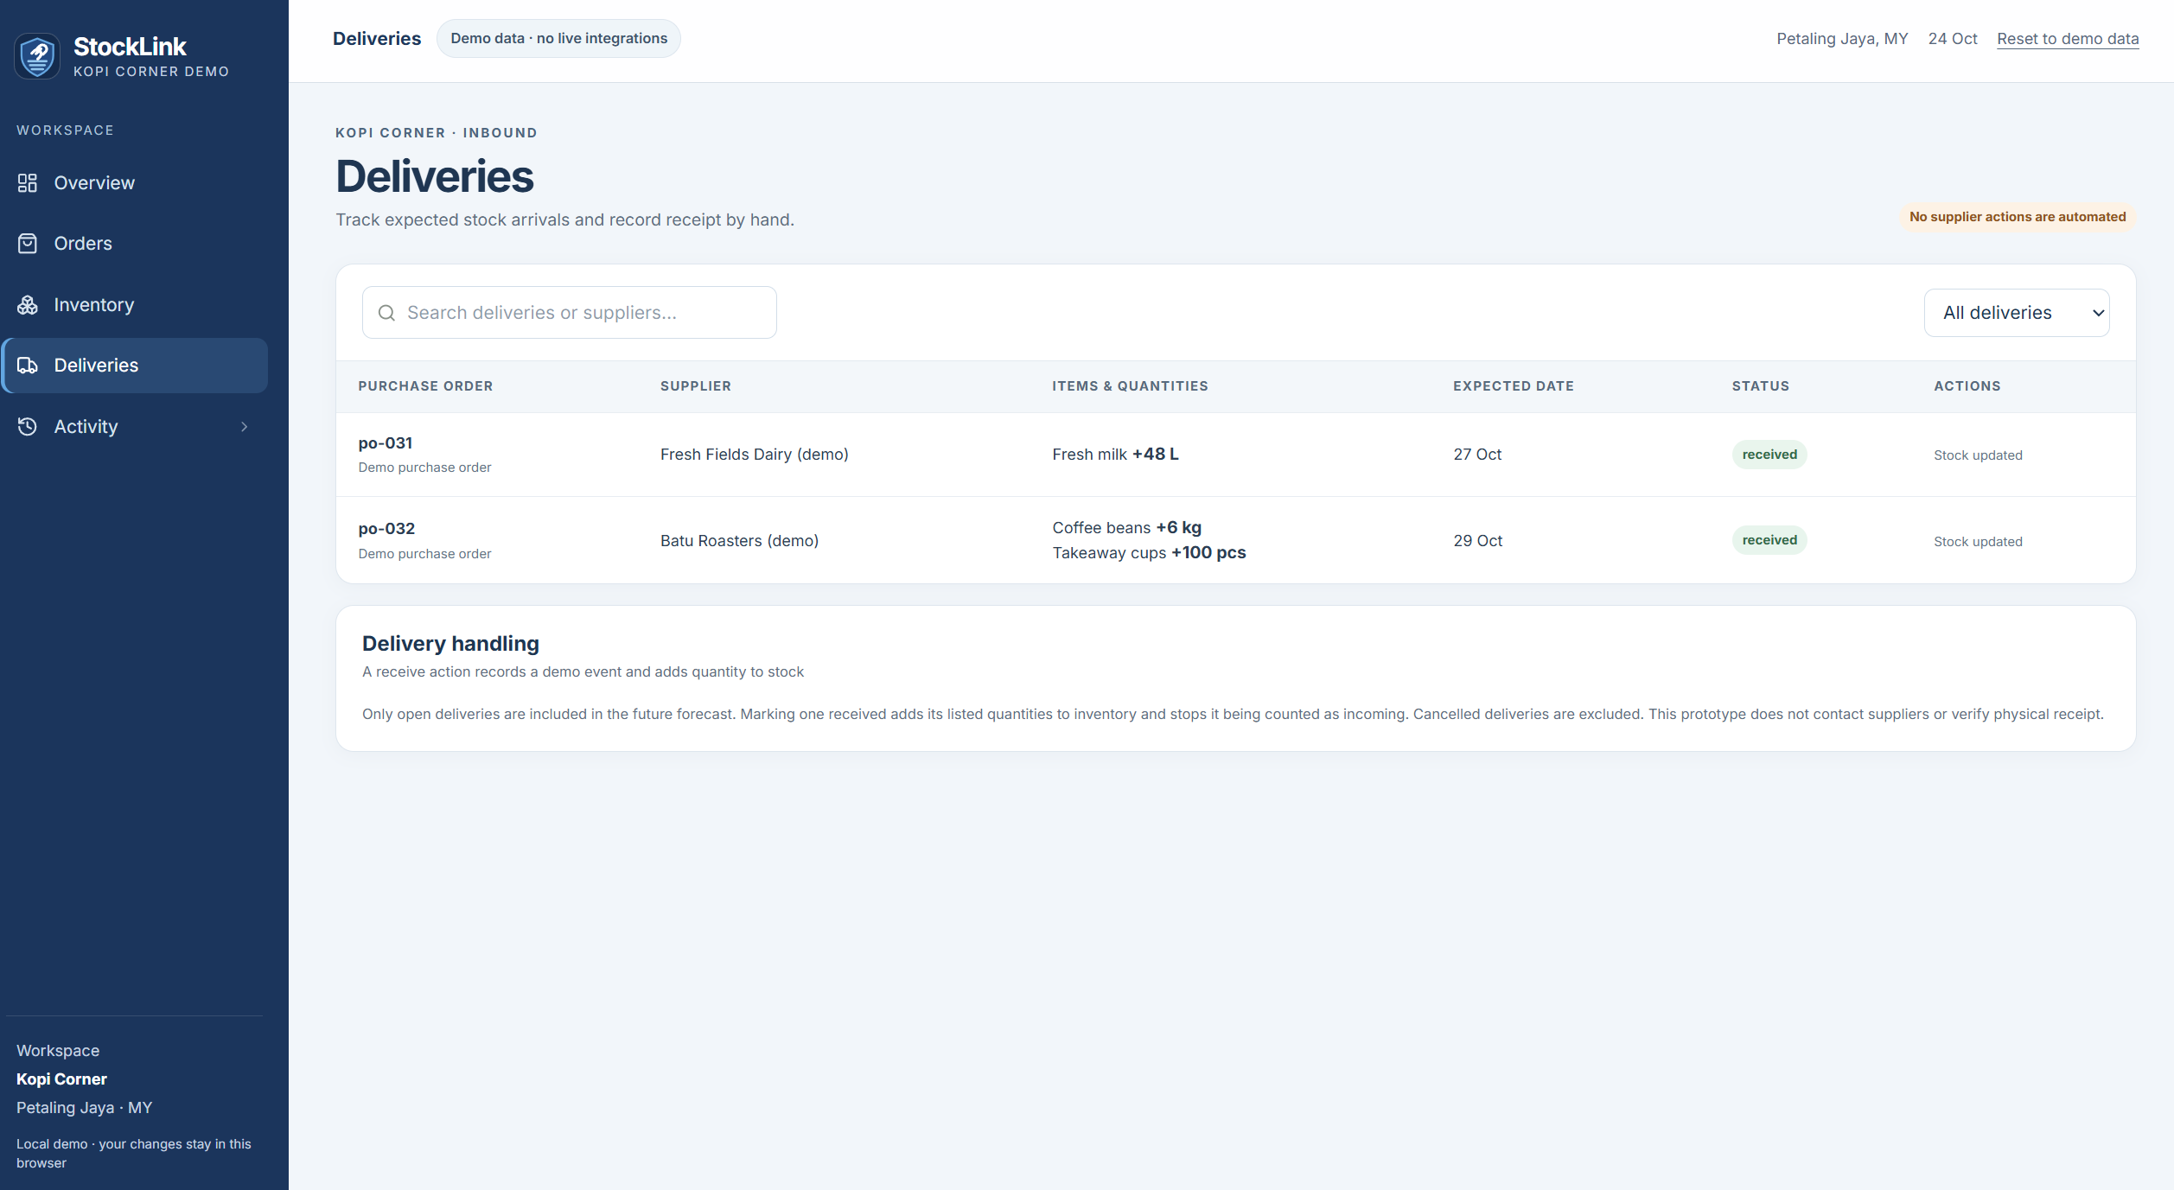
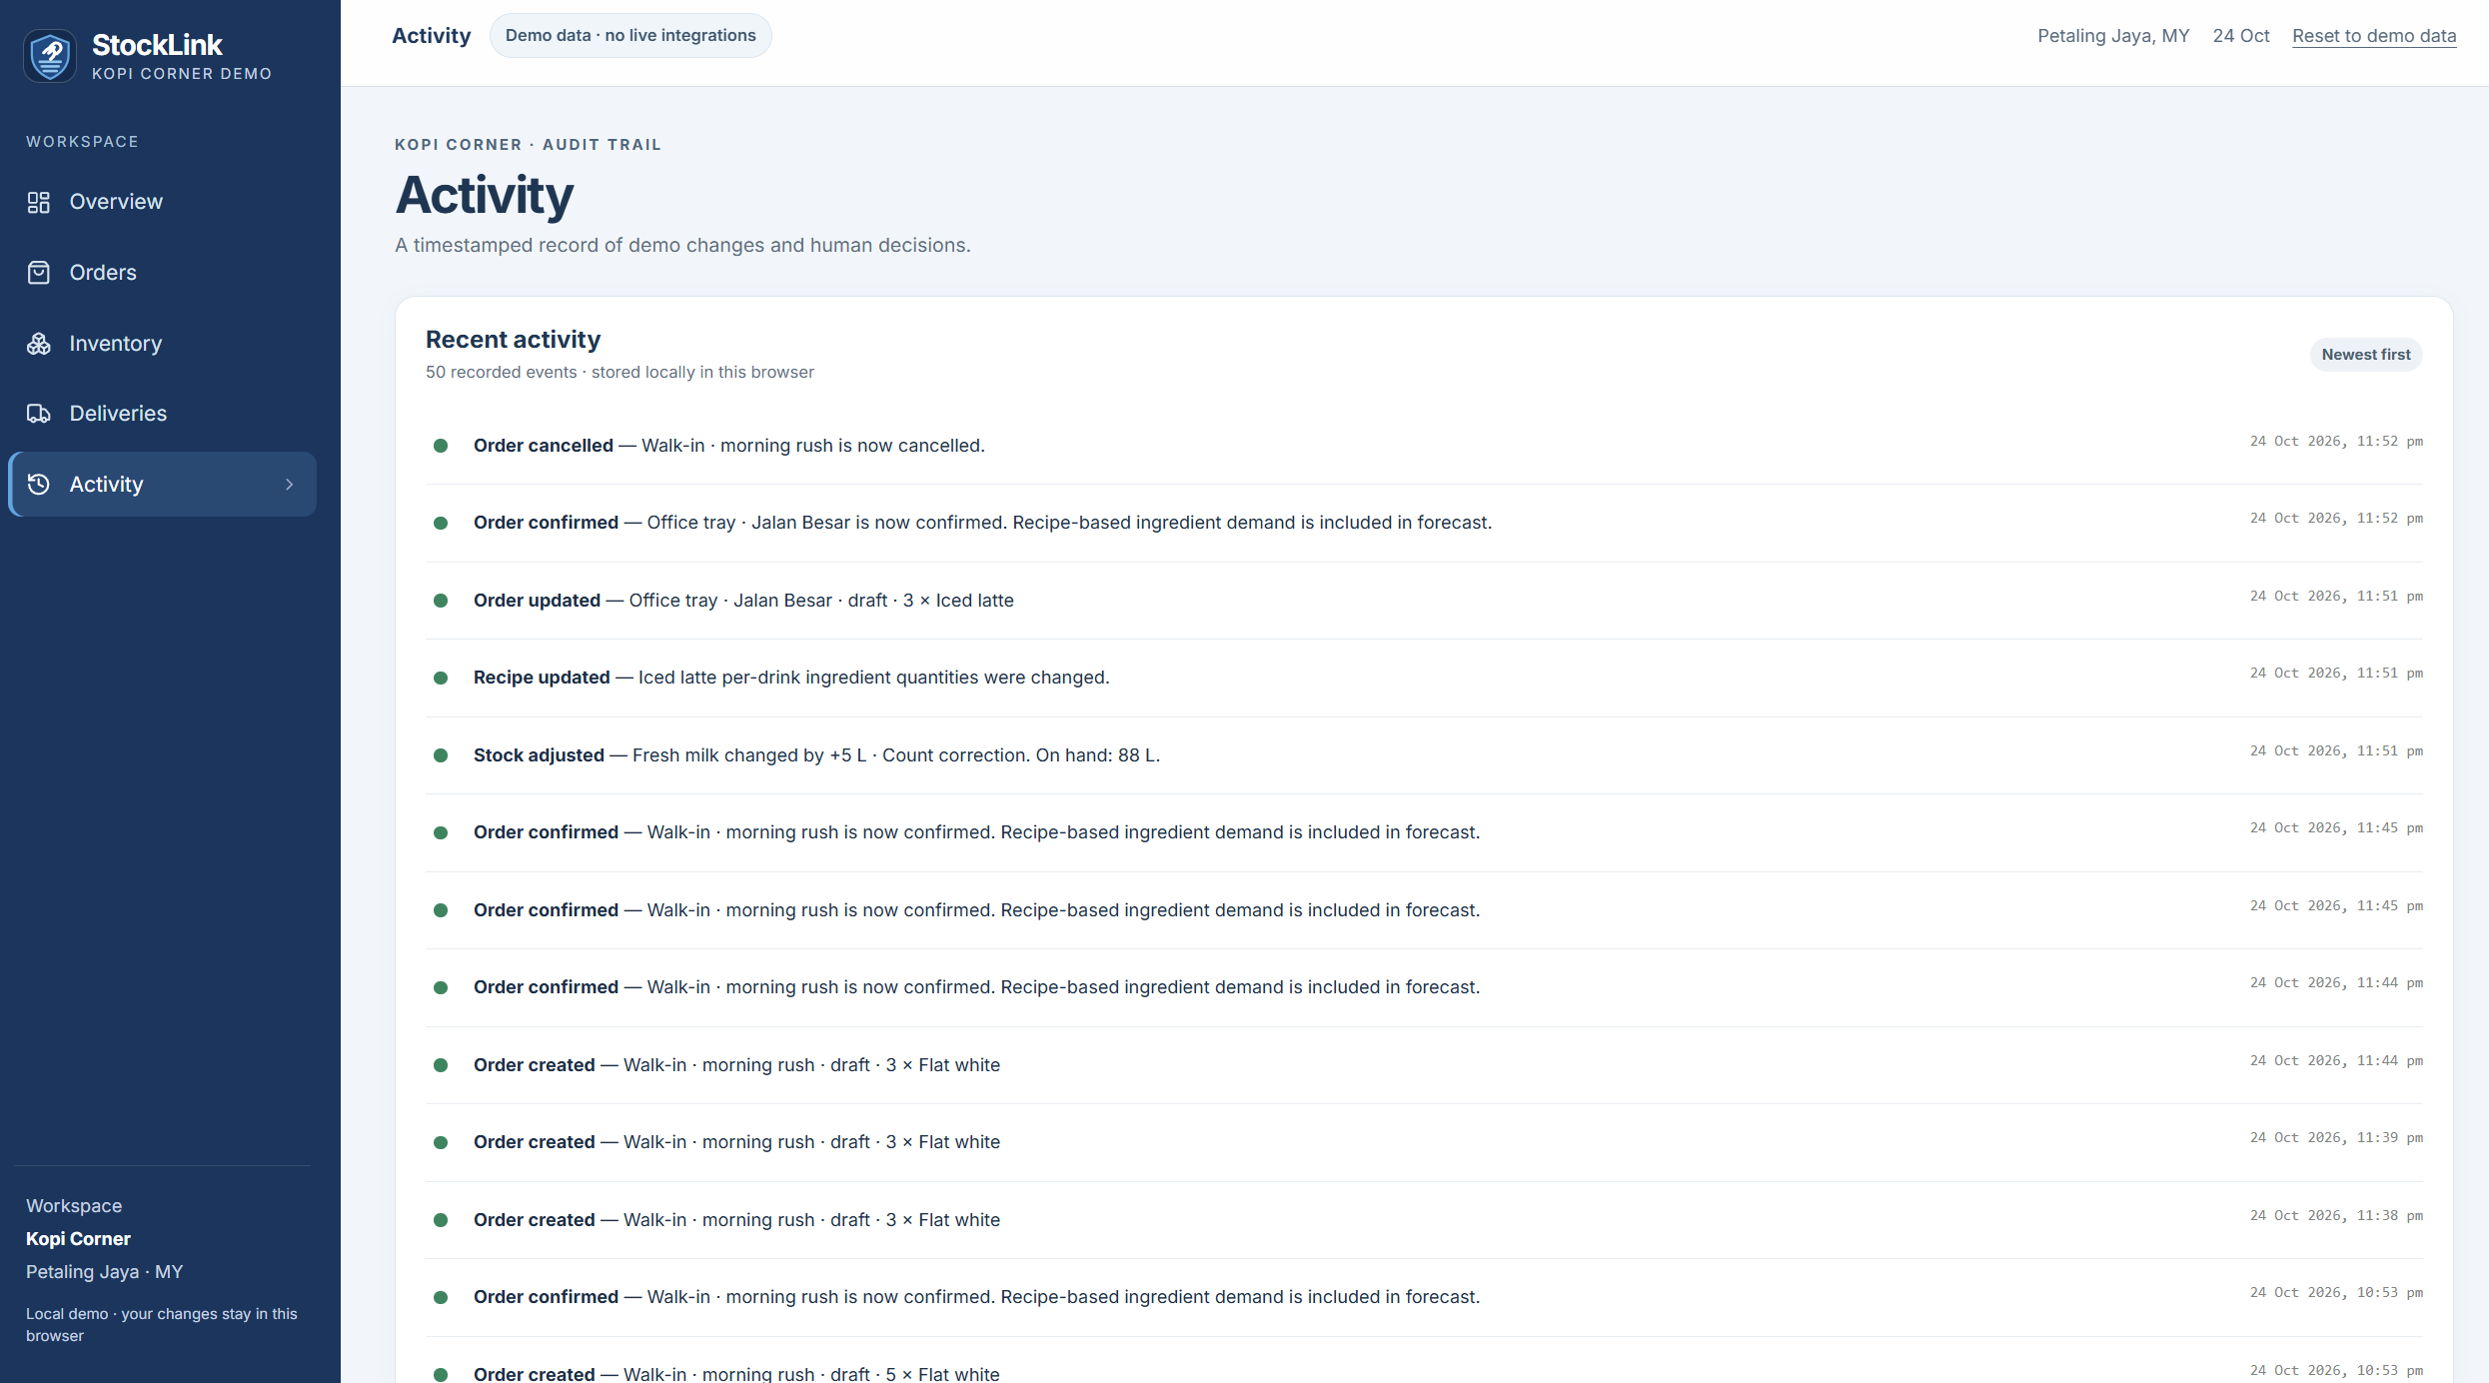

Slide 12
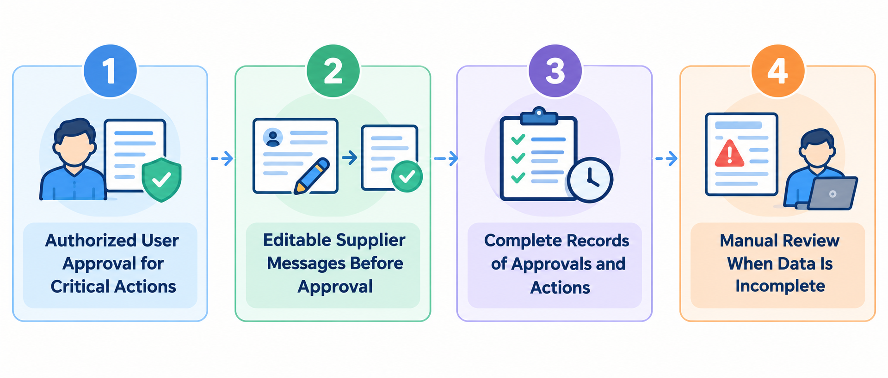
Human in Control
Automation with Human Oversight
Automation identifies problems and prepares actions. Humans decide whether to execute them.

Slide 13


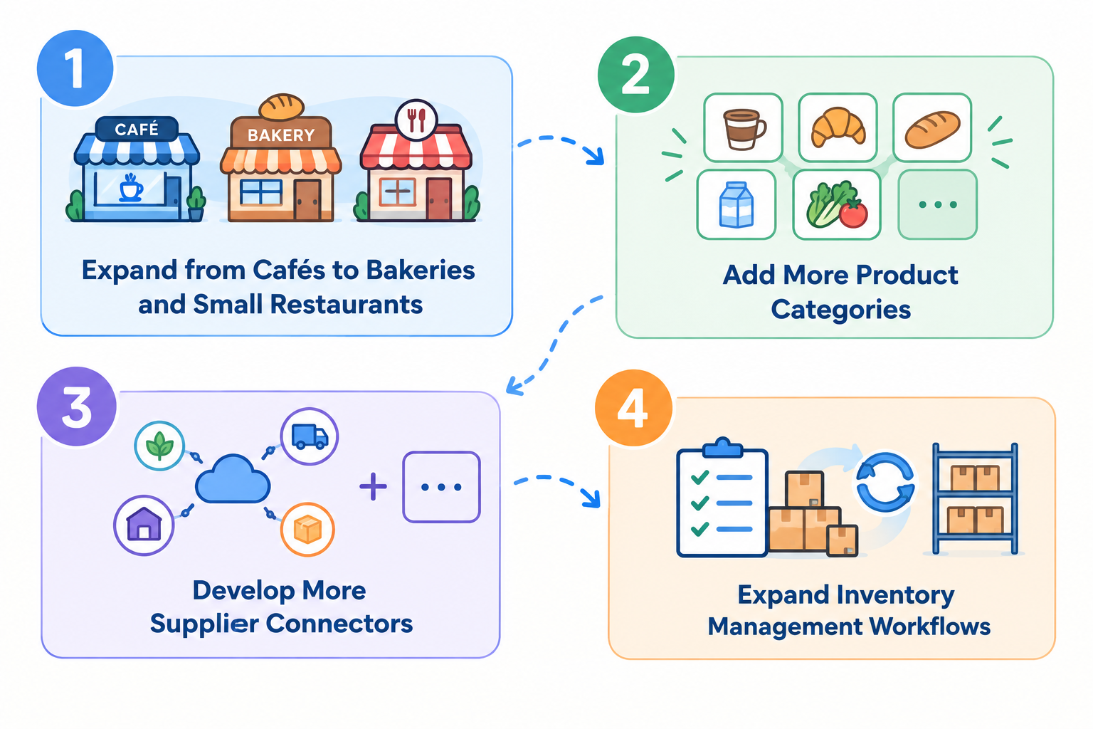
Business Impact & SDGs
Less Manual Work,Fewer Surprises
Business model：
Automation identifies problems and prepares actions. Humans decide whether to execute them.

Slide 14
Business Model & Scalability
Designed to Scale with Small Businesses
Potential for a monthly subscription or freemium model.
Expansion from cafés to bakeries and small food service businesses.
Subsequent addition of more product categories, supplier connectors, and inventory workflows.

Slide 15
Why would a business pay for StockLink?
The value proposition is preventing avoidable disruption — not adding another dashboard.
VALUE FOR THE CUSTOMER
POTENTIAL REVENUE MODEL
• Protect sales: identify likely shortages before they affect orders.
• Control waste: make replenishment decisions with demand and stock context.
• Save staff attention: reduce repetitive checking and supplier follow-up.
• Improve consistency: use a repeatable workflow instead of relying on memory.
Subscription per outlet, with plans based on workflow needs and support.
Possible packaging
• Starter: core stock-risk alerts and forecast.
• Growth: purchase-order tracking and approval workflow.
• Multi-outlet: shared oversight as the product matures.

Slide 16
Future Development
A staged roadmap that keeps the product practical, explainable and reusable.
NOW · MVP
NEXT · PILOT
LATER · SCALE
Reliable core workflow
Validate with real workflows
Connect and expand
• Synthetic orders, recipes and stock data
• Forecast and explain shortage risks
• Human approval and activity log
• Observe how staff actually manage stock
• Measure alert usefulness and response
• Improve setup and reduce false alerts
• Add integrations through standard interfaces
• Support more outlets and reusable workflows
• Explore analytics where data supports it
Long-term direction: Become a reusable SME operations workflow that can connect with the wider Orbyte ecosystem.

Slide 17
Why StockLink?
Order-aware inventory automation for Malaysian micro and small businesses.
Connect orders, stock and incoming deliveries — then explain what needs attention.
Connected view
Earlier warning
Brings order demand, ingredient stock and purchase-order ETAs into one workflow.
Flags potential shortages before expected replenishment arrives.
Explainable alerts
Human in control
Shows the stock, demand and delivery facts behind each risk.
People review recommendations and approve consequential actions.
Differentiator: Not just a low-stock alert — it considers demand timing and expected deliveries.

Slide 18
Product Link:
https://stock-link.replit.app
GitHub Repository:
https://github.com/RM15-Refunders/StockLink

Slide 19
THANK YOU!
THE END

